Slide 1

Wealthsimple
Live Case
Josh, Divraj, Tarun, Joseph & Rhea
“True North Consulting”
Image Source: https://brainstation.io/magazine/wealthsimple-takes-on-big-banks-with-new-spending-account

Slide 2







Todays Journey:
Slides 1-9
Recommendation Breakdown
Slides 10-12
Implementation Plan
Slides 13-14
Comparative Advantage over Competitors
Slides 15-17
Customer Acquisition Cost Breakdown
Slides 18-19
Supporting Study – Virtual Lab Simulation
Slide 20
Alternative Decision Matrix
Slide 21
Risks and Mitigations

Slide 3

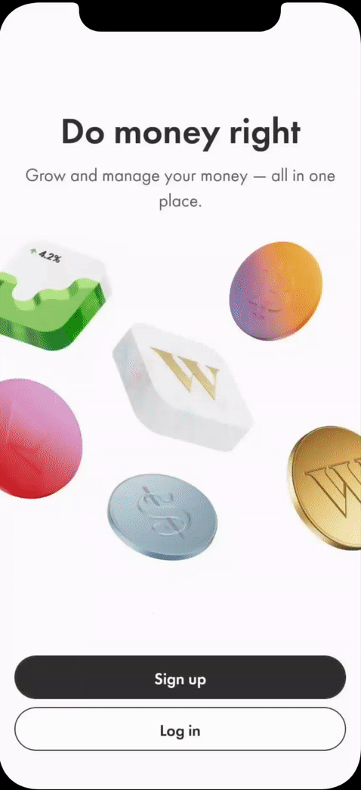


Features of The “Student Starter Platform”
Condensed Version of Educational Resources
Reformat existing educational resources & add video alternatives
Simulation for WS Trading and Crypto
Hands-on experience in investing and trading without the risk
Benefits/Discounts with WS Cash/Cash Card
Access to discounts only accessible through WS cash
Alternatives
Matrix
Recommendation
Implementation
Plan
Risks &
Mitigations
Comparative Advantage
CAC
Breakdown
Supporting
Study

Slide 4



Marketing Exhibit on Campus:
Students can explore the platform
Set up in high traffic areas on campus
Wealthsimple representative on campus to answer any questions
Alternatives
Matrix
Recommendation
Implementation
Plan
Risks &
Mitigations
Comparative Advantage
CAC
Breakdown
Supporting
Study

Slide 5
A Good Solution Follows These Criteria:
2
1
3
Encourages consistent engagement with range of WS products
Highlights a distinct competitive advantage
Identify ways to help Gen Z make better financial choices
Immediate Issue
Underlying Issues
Convincing consumers to adopt range of WS products
Customer Acquisition is too high
HIGH Customer Propensity To Switch
Consistent engagement
Lack of trust - hesitancy to share financial access
Alternatives
Matrix
Recommendation
Implementation
Plan
Risks &
Mitigations
Comparative Advantage
CAC
Breakdown
Supporting
Study

Slide 6
A Good Solution Follows These Criteria:
2
1
3
Encourages consistent engagement with range of WS products
Highlights a distinct competitive advantage
Identify ways to help Gen Z make better financial choices
Immediate Issue
Underlying Issues
Convincing consumers to adopt range of WS products
Customer Acquisition is too high
HIGH Customer Propensity To Switch
Consistent engagement
Lack of trust - hesitancy to share financial access
Alternatives
Matrix
Recommendation
Implementation
Plan
Risks &
Mitigations
Comparative Advantage
CAC
Breakdown
Supporting
Study

Slide 7




Our Recommendation Yields Positive Results:
Student gain more knowledge on personal finance
Attract students to use WS app
Increase volume & Product Adoption
in long run
Alternatives
Matrix
Recommendation
Implementation
Plan
Risks &
Mitigations
Comparative Advantage
CAC
Breakdown
Supporting
Study

Slide 8
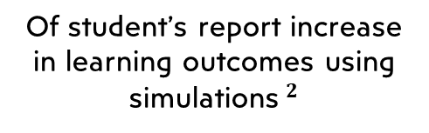

Tech and Simulations Provide Greater Educational Experiences:
Info. retain through video vs. info. retained through text$^{5}$
Of student’s report increase in learning outcomes using simulations$^{2}$
Of Gen Z value technological innovation$^{4}$
Gen-Z Yearns for Innovative, Applied Learning Resources
Alternatives
Matrix
Recommendation
Implementation
Plan
Risks &
Mitigations
Comparative Advantage
CAC
Breakdown
Supporting
Study

Slide 9
Tech and Simulations Provide Greater Educational Experiences:
Info. retain through video vs. info. retained through text$^{5}$
Of student’s report increase in learning outcomes using simulations$^{2}$
Of Gen Z value technological innovation$^{4}$
Gen-Z Yearns for Innovative, Applied Learning Resources
Alternatives
Matrix
Recommendation
Implementation
Plan
Risks &
Mitigations
Comparative Advantage
CAC
Breakdown
Supporting
Study

Slide 10



Implementation Plan:
Refer to Exhibit F for a more detailed breakdown
Short Term
2 – 3 Months
Medium Term
4-7 Months
Long Term
8 – 12 Months
Determine project goals
Assign development roles for the simulation
Establish a supplier for the exhibit (Refer to Exhibit G)
Continue building the Student Starter Platform
Begin re-purposing masterclass modules
Contact Universities for access to campus space (Refer to Exhibit G)
Launch simulation
Roll out campus marketing initiative
Fix any errors and problems within the simulation upon receiving user feedback (Refer to Exhibit G)
Alternatives
Matrix
Recommendation
Implementation
Plan
Risks &
Mitigations
Comparative Advantage
CAC
Breakdown
Supporting
Study

Slide 11
Implementation Plan:
Refer to Exhibit F for a more detailed breakdown
Short Term
2 – 3 Months
Medium Term
4-7 Months
Long Term
8 – 12 Months
Determine project goals
Assign development roles for the simulation
Establish a supplier for the exhibit (Refer to Exhibit G)
Continue building the Student Starter Platform
Begin re-purposing masterclass modules
Contact Universities for access to campus space (Refer to Exhibit G)
Launch simulation
Roll out campus marketing initiative
Fix any errors and problems within the simulation upon receiving user feedback (Refer to Exhibit G)
Alternatives
Matrix
Recommendation
Implementation
Plan
Risks &
Mitigations
Comparative Advantage
CAC
Breakdown
Supporting
Study

Slide 12
Implementation Plan:
Refer to Exhibit F for a more detailed breakdown
Short Term
2 – 3 Months
Medium Term
4-7 Months
Long Term
8 – 12 Months
Determine project goals
Assign development roles for the simulation
Establish a supplier for the exhibit (Refer to Exhibit G)
Continue building the Student Starter Platform
Begin re-purposing masterclass modules
Contact Universities for access to campus space (Refer to Exhibit G)
Launch simulation
Roll out campus marketing initiative
Fix any errors and problems within the simulation upon receiving user feedback (Refer to Exhibit G)
Alternatives
Matrix
Recommendation
Implementation
Plan
Risks &
Mitigations
Comparative Advantage
CAC
Breakdown
Supporting
Study

Slide 13

The Student Starter Platform is a Unique Customer Experience:
Student-Starter Platform
01
Platform to Explore
Explore how to use the RBC investing platform through the practice account
Multiple Services Offered
01
Offers learning resources, simulation, benefits and discounts
02
Service Offered to Few
Only offered to RBC Online Banking OR Direct Investing Clients
Service for Students
02
Offered to students throughout their university careers.
03
Short-Term Use
Meant to act as an exploration platform to understand the functionality of RBC’s investing platform
03
Strong Client Relationship
Platform offers multiple services to retain students as long-term customers.
RBC Practice Account$^{8}$
The student starter platform has a distinct competitive advantage above all competing financial platforms
Alternatives
Matrix
Recommendation
Implementation
Plan
Risks &
Mitigations
Comparative Advantage
CAC
Breakdown
Supporting
Study

Slide 14

The Student Starter Platform is a Unique Customer Experience:
Student-Starter Platform
01
Platform to Explore
Explore how to use the RBC investing platform through the practice account
Multiple Services Offered
01
Offers learning resources, simulation, benefits and discounts
02
Service Offered to Few
Only offered to RBC Online Banking OR Direct Investing Clients
Service for Students
02
Offered to students throughout their university careers.
03
Short-Term Use
Meant to act as an exploration platform to understand the functionality of RBC’s investing platform
03
Strong Client Relationship
Platform offers multiple services to retain students as long-term customers.
RBC Practice Account$^{8}$
The student starter platform has a distinct competitive advantage above all competing financial platforms
Alternatives
Matrix
Recommendation
Implementation
Plan
Risks &
Mitigations
Comparative Advantage
CAC
Breakdown
Supporting
Study

Slide 15



Cheapening Customer Acquisition Cost:
Our development-first approach allows WS to marginally lower CAC
Our recommendation has effectively reduced CAC to below $1 (Marketing-only)
As time goes on, CAC will cheapen because of the low carrying + variable cost
Refer to Exhibit H for a more detailed analysis
Alternatives
Matrix
Recommendation
Implementation
Plan
Risks &
Mitigations
Comparative Advantage
CAC
Breakdown
Supporting
Study

Slide 16
Cheapening Customer Acquisition Cost:
Our development-first approach allows WS to marginally lower CAC
Our recommendation has effectively reduced CAC to below $1 (Marketing-only)
As time goes on, CAC will cheapen because of the low carrying + variable cost
Refer to Exhibit H for a more detailed analysis
Alternatives
Matrix
Recommendation
Implementation
Plan
Risks &
Mitigations
Comparative Advantage
CAC
Breakdown
Supporting
Study

Slide 17
Cheapening Customer Acquisition Cost:
Our development-first approach allows WS to marginally lower CAC
Our recommendation has effectively reduced CAC to below $1 (Marketing-only)
As time goes on, CAC will cheapen because of the low carrying + variable cost
Refer to Exhibit H for a more detailed analysis
Alternatives
Matrix
Recommendation
Implementation
Plan
Risks &
Mitigations
Comparative Advantage
CAC
Breakdown
Supporting
Study

Slide 18
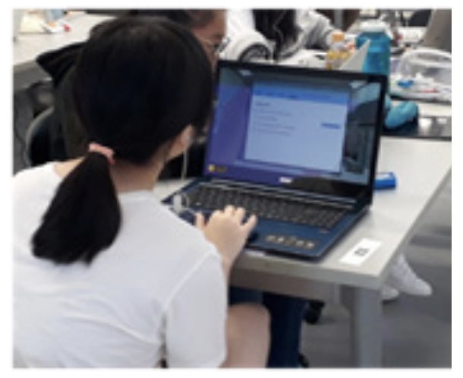




Virtual Lab Simulation – Supporting Study :
Purpose$^{2}$
Goal$^{2}$
Do simulations lead to an increase in
student knowledge
motivation to study
self-efficacy
“Provide engaging and interactive way for Gen Z students to learn and understand key biology concepts”
(Biggs et al., 2019)
Source: Journal of Applied Learning and Teaching Vol.2 No.2 (2019)
Alternatives
Matrix
Recommendation
Implementation
Plan
Risks &
Mitigations
Comparative Advantage
CAC
Breakdown
Supporting
Study

Slide 19

Virtual Lab Simulation – Supporting Study:
Survey Questions$^{2}$
Survey Results
1
I gained relevant knowledge by using the simulation
2
I found the simulation motivating
I feel more confident about my lab skills after the simulation
3
I feel that I can apply what I have learned in the simulation to real world cases
4
In general, I was pleased with the simulation
5
(Biggs et al., 2019)
Simulation clearly encourages consistent engagement, real-world application, and motivation
Alternatives
Matrix
Recommendation
Implementation
Plan
Risks &
Mitigations
Comparative Advantage
CAC
Breakdown
Supporting
Study

Slide 20
The Student Starter Platform is Superior vs. Previous Campaigns:
Features | Student Starter Platform | Free Food Promotion | Digital Ads | Referrals
Provides WS with a distinct competitive advantage
Encourages consistent engagement with WS
Low acquisition costs
Helps Gen Z make better financial choices
Refer to Exhibit E for a more detailed analysis
Alternatives
Matrix
Recommendation
Implementation
Plan
Risks &
Mitigations
Comparative Advantage
CAC
Breakdown
Supporting
Study

Slide 21
Major Risks Successfully Mitigated Through Strategy:
High
Risks
Mitigations
Implement on-campus marketing exhibits to attract students
Impact
Low Student Engagement
Low
Contingency:
Run additional smaller exhibits across campus
Low
Likelihood
High
Refer to Exhibit I for a more details
Alternatives
Matrix
Recommendation
Implementation
Plan
Risks &
Mitigations
Comparative Advantage
CAC
Breakdown
Supporting
Study

Slide 22
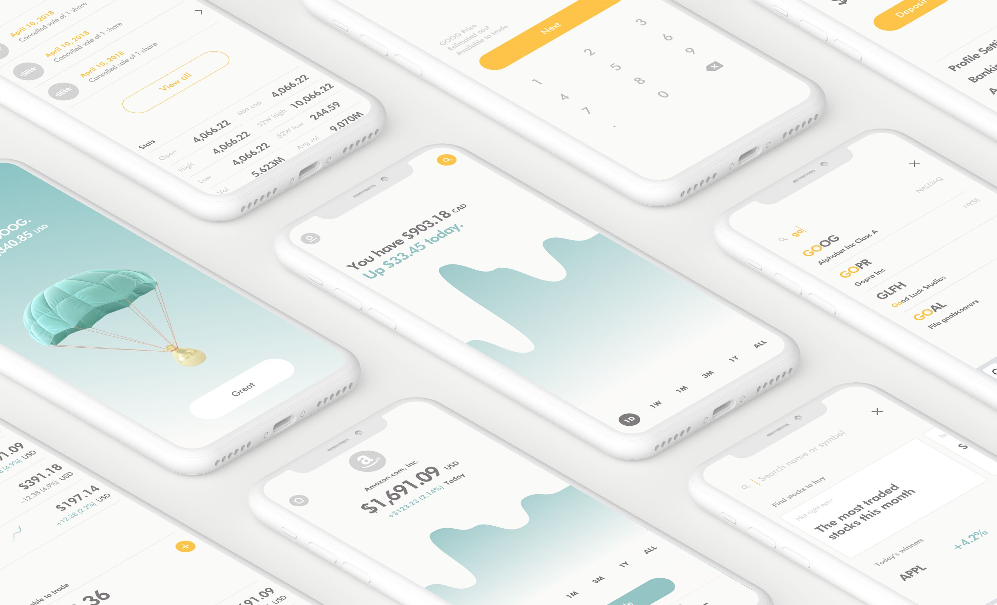
We Will Now Be Accepting Any Questions
Image Source: https://www.theglobeandmail.com/investing/article-wealthsimple-launching-zero-commission-trading-platform/

Slide 23
Exhibit A – Recommendation Alignment With WS Values
Exhibit B – Porter’s Five Forces (Banking Industry)
Exhibit C – Porter’s Five Forces (Retail Savings and Investments)
Exhibit D – Diamond-E Analysis
Exhibit E – Comparison of Alternative Solutions
Exhibit F – Gantt Chart
Exhibit G – On-Campus Exhibit
Exhibit H – Customer Acquisition Cost Breakdown
Exhibit I – Risk, Mitigation and Contingency Plan Exhibit J – University Incentive
Exhibit K – App Prototype Breakdown
Exhibit L – Effectiveness of On-Campus Marketing Initiative
Exhibit M – CAC Capturing Only 5% Of Students
Exhibit N – Simulation Study Results
Appendix:
Image Source: https://www.theglobeandmail.com/investing/article-wealthsimple-launching-zero-commission-trading-platform/

Slide 24
Exhibit A - Recommendation Alignment with WS Values
- Credit $25/account to encourage investment journey
- Offer a stock simulation to build consumer trust and confidence
Keeping it Simple
Ship it, then Improve it
- The Student Starter Platform focuses on making it as cost effective as possible
- For the consumer, sign up is free, along with a $25 bonus
Focus on the Client
Make it Cost Less
- Simple addition to the existing application
- Add multiple consumer benefits
- Have guidance from top employers
- WS will constantly add new features and additions as they acquire consumer feedback
- Value consumer needs, and will adjust product when needed
Appendix Home

Slide 25
Exhibit B – Porter's Five Forces Banking⁷
Buyer Power | Supplier Power | Threat of New Entrants | Threat of Substitutes | Degree of Rivalry
Moderate | Strong | Moderate | Weak | Strong
Most buyers are insignificant due to the large number of buyers Some very large ‘key clients’ are very significant Banks are essential due to being required to receive your salary Low differentiation leads to more customers switching Little to no switching costs for individuals High switching costs for large businesses | Banks need good information and communication technology (ICT) Suppliers of ICT have increased power due to the complex nature of creating it Visa and Mastercard hold lots of power due to their large market share as payment providers Very few companies can provide the physical infrastructure banks need Employees being trained for a certain system that can create switching costs Banks are unlikely to integrate backwards | Regulation requires banks to have a large amount of capital Brand recognition is important as customers need to trust who they’re banking with Digital banking is easier for new firms to enter as it is newer and less established The high level of regulation in the industry leads to high operating costs | Gifts and loans are the largest substitute, but often have very limited capital available Loan sharks and payday lenders are other substitutes, but the lower regulation gives them a weak reputation The available substitutes can only substitute specific aspects of banking Electronic transactions can be substituted by non-financial institutions such as PayPal | There’s many firms competing for different segments or niches but because of regulation there are a small number of banks Limited differentiation creates more competition Efficiency is important in the industry Covid decreased the profitability in the industry and increased the rivalry in the market
Appendix Home

Slide 26
Exhibit C – Porter's Five Forces Retail Savings and Investments⁶
Buyer Power | Supplier Power | Threat of New Entrants | Threat of Substitutes | Degree of Rivalry
Moderate | Strong | Weak | Moderate | Moderate
The focus on individual consumers leads to lower buyer power The large number of potential customers also weakens buyer power As the market is just business to consumer, there is no threat of backward integration | Having good information and communication technology (ICT) has become more and more important The complexity of the ICT required makes it so that only a few firms can provide it The complexity also greatly lowers the chances of backwards integration | The recent economic downturn lowers the chances of new entrants The large amount of capital required deters firms from entering Reputation is extremely important which makes it difficult for firms trying to enter the industry Financial technology is currently the easiest way for a firm to enter the market as it is newer and less established Low interest rates deter firms from entering the market as it decreases profitability | Substitutes include investment in real estate, hedge funds, life insurance and pension schemes If housing prices begin to go down as they are expected to do, the threat of real estate being a substitute will decrease The Canada Pension Plan is considered one of the best pension systems in the world meaning its threat of substitution is greater than in most other countries | Downturns in the market lead to increased competition as companies compete to increase their profit The difficulty to differentiate yourself from the competitors increases the degree of rivalry Exit costs are very high which increases competition
Appendix Home

Slide 27
Exhibit D – Diamond-E Analysis
Management Preferences
Wealthsimple focuses on the client providing customized solutions as well as demanding diversity and inclusion both in their workplace and for their customers. They emphasize simple and accessible product. When it comes to new products or features, they look for feedback, and prefer to release it and then improve it
Organization
Wealthsimple focuses on creating financial platforms for various needs consumers may have. Using digital platforms allows their products to be easily and conveniently used by many people. The company is organized in a way that encourages innovation.
Strategy
Wealthsimple employs the strategy of making products with a broad appeal. They do this by making their products easy to use and understand as well as providing them for a low cost and being transparent.
Environment
Wealthsimple is well aligned with its environment as it provides multiple fintech (financial technology) platforms. Fintech is the newest, fastest growing and easiest to enter section of the financial industry
Resources
Weatlhsimple has received over $900 million in funding and has a valuation of about $4 billion. They have 1248 employees and an estimated annual revenue of about $232 million.^{3, 9}
Appendix Home

Slide 28
Exhibit E: Comparison of Alternative Solutions
Our solution | Alternative Solutions
Student Starter Pack | Free Food Promo | Digital Ads | Referrals
Great way to promote to young customers that are still new to finance | Very manually intensive | Not good for targeting specific audiences | Requires an already established customer base
Mostly a fixed cost so as more customers are acquired the customer acquisition cost is lowered | CAC of $20 | CAC of $200 | CAC of $50
 | Blended customer acquisition cost of $125
Uses new additions to encourage hands on learning | Don't offer any additional educational help to students
Adds a gamified aspect which is more engaging | All the focus is on the initial customer acquisition not consistent engagement in the future
Builds brand trust and recognition with students while they are the most financially impressionable | Solutions are not unique and are easy for competitors to replicate
Appendix Home

Slide 29
Exhibit F - Gantt Chart
Tasks | 1 | 2 | 3 | 4 | 5 | 6 | 7 | 8 | 9 | 10 | 11 | 12
Establish infrastructure for creating simulation
Redelegate existing employees to develop/design Student Starter Pack and simulation
Begin establishing connections to source the exhibit
Create the simulation and Student Starter Pack
Reformat existing resources to fit the profile of “Student Starter Platform”
Launch Student Starter Platform
Acquire the discounts/partnerships with surrounding businesses
Contact Universities for access to campus space
Implement marketing on campus
Track consumer feedback and fix any errors
Contact surrounding businesses for offers to use within Cash
Short Term | Medium Term | Long Term
Appendix Home

Slide 30
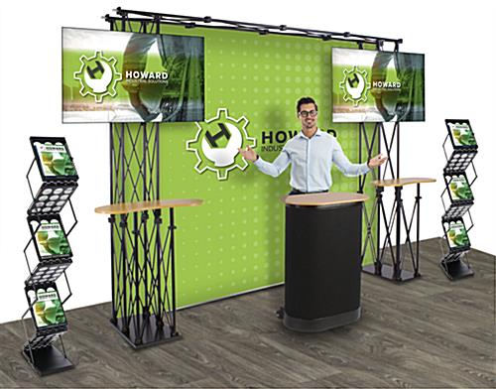
Exhibit G – Wealthsimple Exhibit
Exhibit style inspiration drawn from here:
Follows WS Color Scheme:
Notes:
- Exhibit is decorated with WS branding
- Accompanied by a WS campus representative
- Easily transportable (10ftx10ft exhibit)
Appendix Home

Slide 31
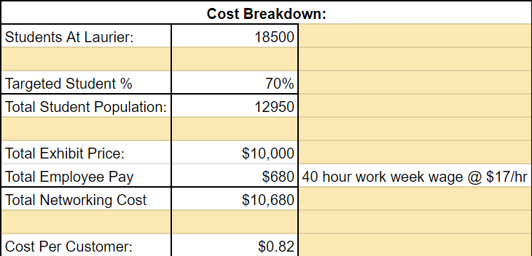
Exhibit H - Customer Acquisition Cost Breakdown:
Appendix Home

Slide 32
Exhibit I – Risks, Mitigations and Contingency
Risks | Mitigation | Contingency
Low engagement from Laurier students | Implement personal, on-campus marketing exhibits to entice students to adopt the new Student Starter Platform | Run additional smaller exhibits across campus, capitalizing on spaces that our main exhibit misses.
Errors within simulation | Perform routine maintenance checks and de-bug program if needed | Temporarily making the simulation unavailable to public while the problem is troubleshot.
Doesn't satisfy the needs of the customer | Revaluate the quality of the resources and simulation, and make any necessary changes | Conduct surveys among app users to strengthen the starter platform
Appendix Home

Slide 33
Exhibit J – University Incentive
Dropout rate of students with mental health problems
Having Good Students
25% of students with a GPA below 8 and had mental health problems dropped out¹⁰
Only 10% of students with similar GPAs but no mental health issues dropped out¹⁰
Students experiencing financial stress are more likely to have depressive symptoms¹¹
Dropout rate of students without mental health problems
Appendix Home
Notes:
http://www.fundraisingafrica.lboro.ac.uk/getting-started/the-role-of-alumni-relations-in-advancement/#:~:text=Alumni%20are%20great%20role%20models,institution%20in%20their%20professional%20lives

Slide 34
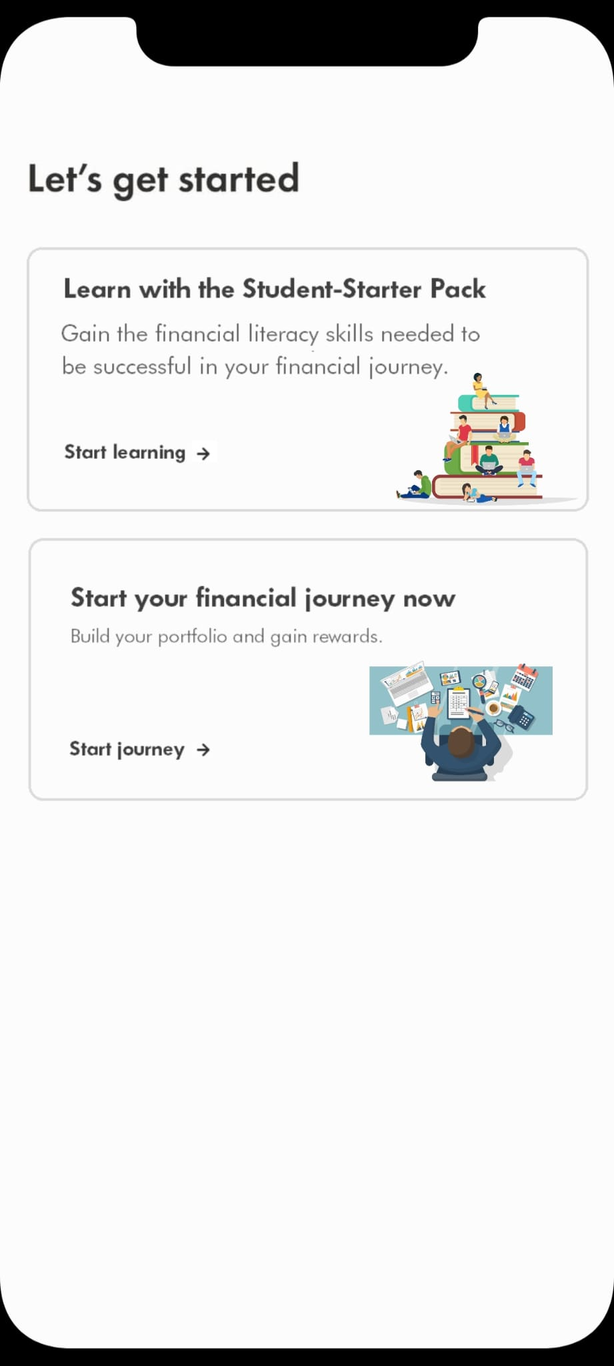
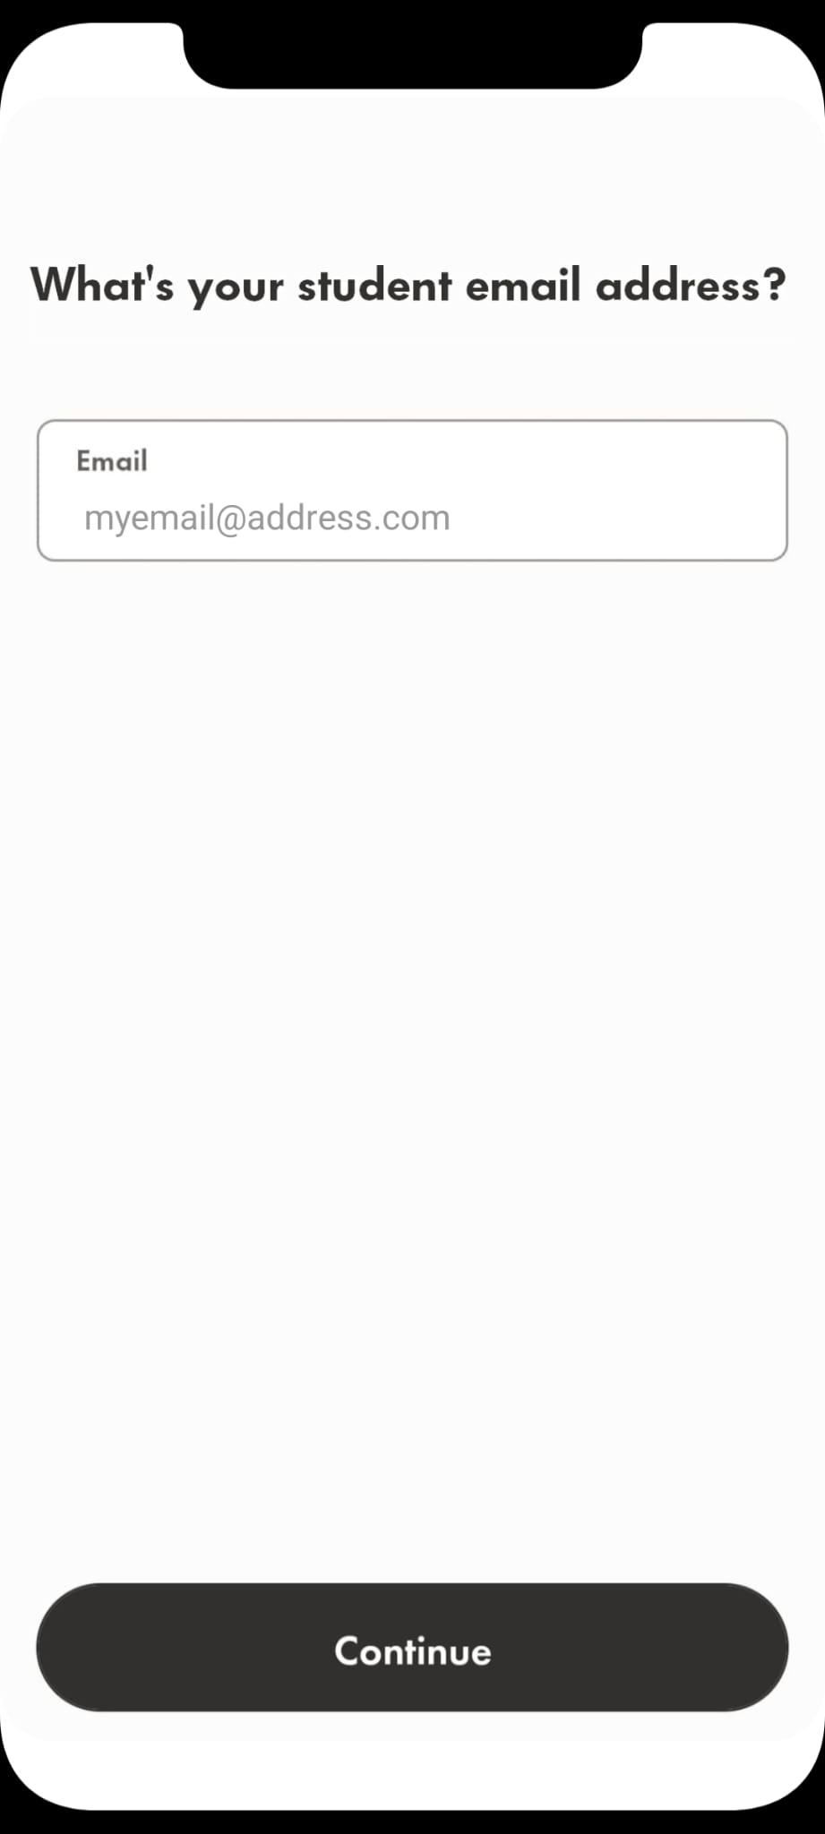
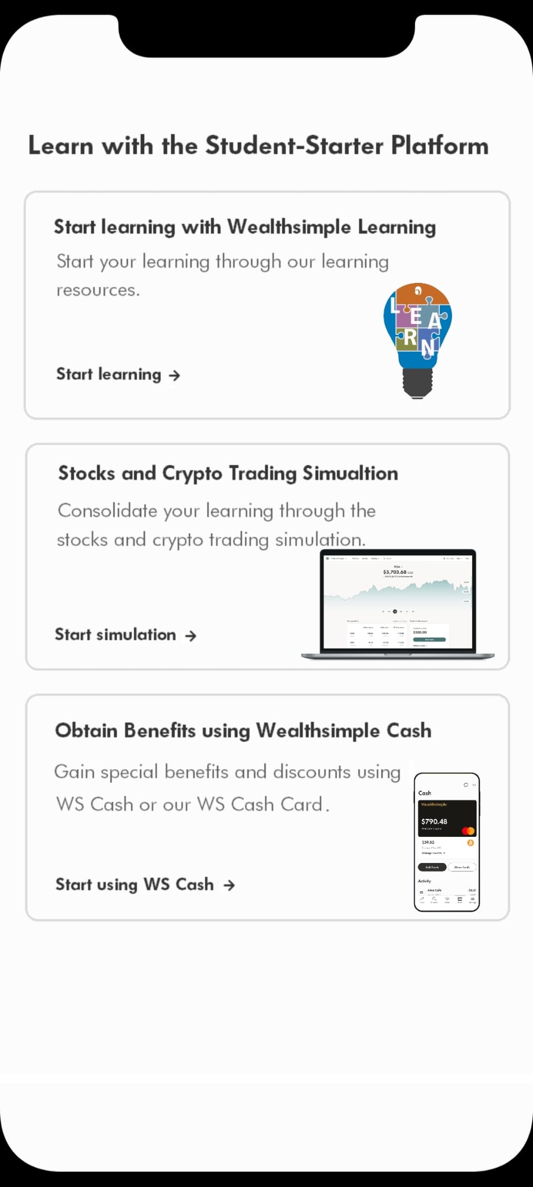
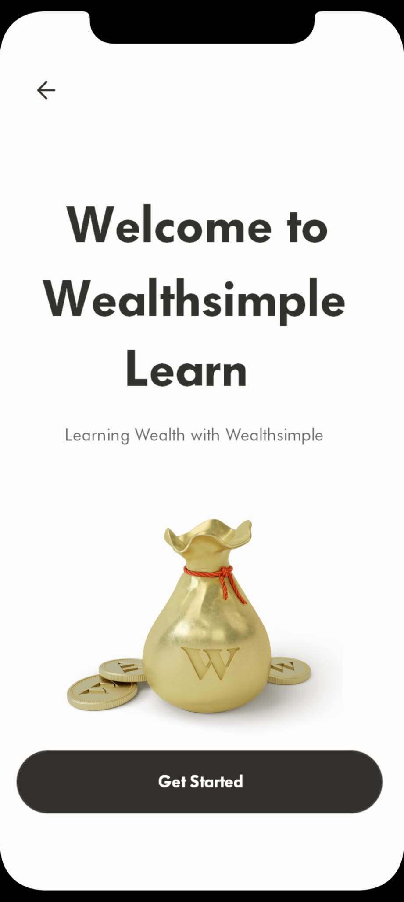
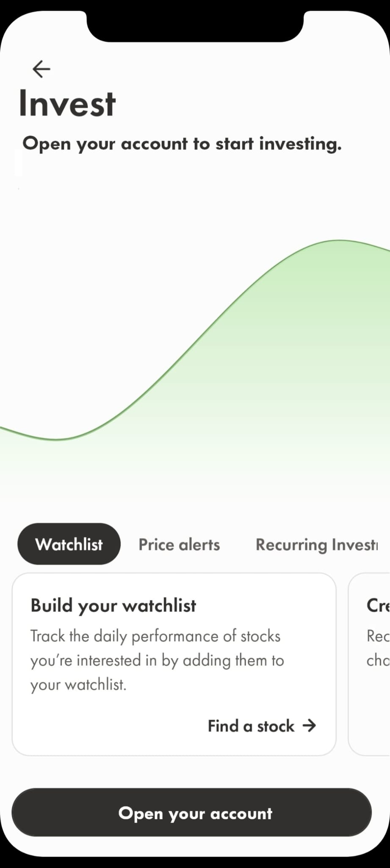
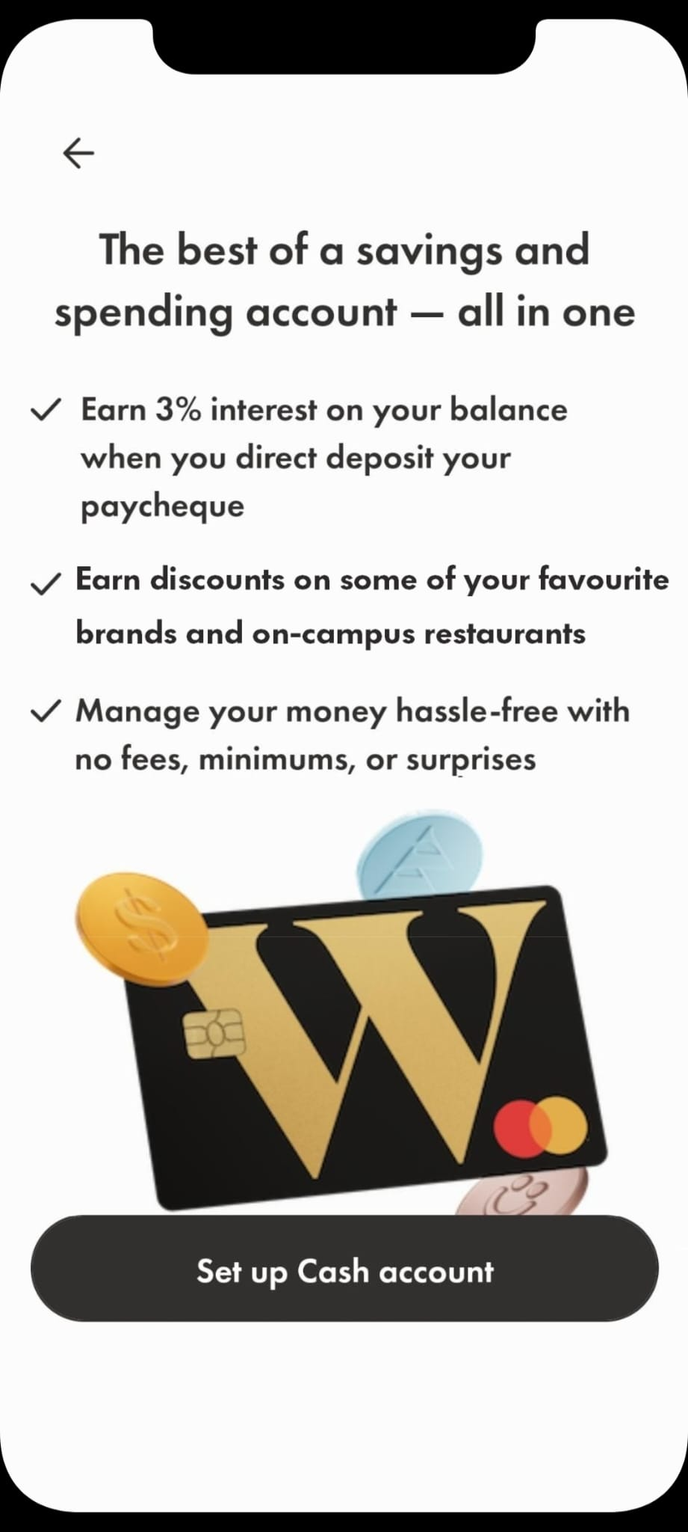
Exhibit K – App Prototype Breakdown
Appendix Home

Slide 35
Exhibit L - Effectiveness of Our On-Campus Marketing Initiative:
75% of respondents agree that an in-person event has made them feel more connected to a brand.¹⁰
81% of brands believe their event and experiential budgets will match or exceed their pre-pandemic budget.¹¹
The absence of personal connections during Covid, paired with the re-opening of campuses and in-person experiences provides students with intrinsic motivation to visit these exhibits.
Appendix Home

Slide 36

Exhibit M - CAC Only Capturing 5% Of Students:
Appendix Home

Slide 37
Exhibit N – Simulation Study Results
Low (n<50)
Medium (50>n<70)
High (n<80)
(Biggs et al., 2019)

Slide 38
References
Andre, L. (2019, July 25). Points, badges, levels, and rewards—these are some of the components of gamification widely used nowadays by o. Financesonline.com; FinancesOnline.com. https://financesonline.com/gamification-statistics/
Biggs, J., Harris, C., & Rudolph, J. (2019). Teaching for Quality Learning at Changing Universities. A tour de force of modern education history. Journal of Applied Learning & Teaching, 2(1), 54–62. https://doi.org/https://d1wqtxts1xzle7.cloudfront.net/60597322/61-Article_Text-217-4-10-2019070120190914-117644-1nzmw9w-libre.pdf?1568514828=&response-content-disposition=inline%3B+filename%3DTeaching_for_Quality_Learning_at_Changin.pdf&Expires=1669581850&Signature=JbG8xuuorQwJC~R2J5wHPh0X2Q2cCwnrtfp9IseqXkzsyBMC6hoPcAQG4c20DClszDILXjSMx9mYtssBI6cOI61C-lkZMgKd17T3SdP03wUBfoftI3T7WmAuIRfNOJThjAbR2SXjW5d4BVJpL4no35YHNQ~hN~NA-JtQEq3FPqtFD1V0jtUrCTZRdgLxwizJYlZfT2ot0viwEcGa3qCNRM4ittiyXJTbr2lMxCzkEM7QRllu5amvVf4hGuNDwSKK8QEzW0vzCjArRXD6btUKl1pJZTKHrPSaVvjTT5aYnj~NG4bKTHbZLwsH0~bL0sFYzwQX4WLGD~bRV~Lm66SluQ__&Key-Pair-Id=APKAJLOHF5GGSLRBV4ZA
Growjo. (n.d.). Wealthsimple: Revenue, Competitors, Alternatives. Growjo.com. Retrieved November 27, 2022, from https://growjo.com/company/Wealthsimple
Jones, E. (2020, July 7). Generation Influence: Gen Z Study Reveals a New Digital Paradigm. Www.businesswire.com. https://www.businesswire.com/news/home/20200706005543/en/Generation-Influence-Gen-Z-Study-Reveals-a-New-Digital-Paradigm
Lister, M. (2018). 37 Staggering Video Marketing Statistics for 2018. Wordstream.com. https://www.wordstream.com/blog/ws/2017/03/08/video-marketing-statistics
Marketline. (2022a, March 10). Canada - Retail Savings & Investments. Marketline. https://advantage-marketline-com.libproxy.wlu.ca/Analysis/IndustryProfile/canada-retail-savings-investments-152136/Five%20Forces%20Analysis
Marketline. (2022b, March 30). Canada - Banks. Marketline. https://advantage-marketline-com.libproxy.wlu.ca/Analysis/IndustryProfile/canada-banks-151545/Five%20Forces%20Analysis
Open a Risk-Free Practice Account with RBC Direct Investing. (n.d.). Www.rbcdirectinvesting.com. https://www.rbcdirectinvesting.com/practice-accounts.html
zoominfo. (n.d.). Wealthsimple - Overview, News & Competitors | ZoomInfo.com. ZoomInfo. Retrieved November 27, 2022, from https://www.zoominfo.com/c/wealthsimple-inc/372438746
Lipson, S., Abelson, S., Ceglarek, P., Phillips, M., & Eisenberg, D. (2019). PREPARED BY THE HEALTHY MINDS NETWORK RESEARCH TEAM. https://vtechworks.lib.vt.edu/bitstream/handle/10919/97778/InvestingStudentMentalHealth.pdf
Peltz, J., Bodenlos, J., Kingery, J., & Rogge, R. (2020, January 15). The role of financial strain in college students’ work hours, sleep, and mental health. Tandfonline. https://www.tandfonline.com/doi/pdf/10.1080/07448481.2019.1705306?needAccess=true

